Slide 1


Big Data Infrastructure
CS 489/698 Big Data Infrastructure (Winter 2017)
Week 11: Analyzing Graphs, Redux (1/2)
March 21, 2017
Jimmy Lin
David R. Cheriton School of Computer Science
University of Waterloo
These slides are available at http://lintool.github.io/bigdata-2017w/
This work is licensed under a Creative Commons Attribution-Noncommercial-Share Alike 3.0 United States See http://creativecommons.org/licenses/by-nc-sa/3.0/us/ for details

Slide 2
Graph Algorithms, again?
(srsly?)

Slide 3
✗
What makes graphs hard?
Fun!
Irregular structure
Fun with data structures!
Irregular data access patterns
Fun with architectures!
Iterations
Fun with optimizations!

Slide 4
Characteristics of Graph Algorithms
Irregular structure and data access patterns!
Parallel graph traversals
Local computations
Message passing along graph edges
Iterations

Slide 5
PageRank: Defined
Given page x with inlinks t₁…t_{n}, where
C(t) is the out-degree of t
α is probability of random jump
N is the total number of nodes in the graph
t₁
X
t₂
…
t_{n}

Slide 6
PageRank in MapReduce
n₁ [n₂, n₄]
n₂ [n₃, n₅]
n₃ [n₄]
n₄ [n₅]
n₅ [n₁, n₂, n₃]
Map
n₂
n₄
n₃
n₅
n₄
n₅
n₁
n₂
n₃
n₁
n₂
n₂
n₃
n₃
n₄
n₄
n₅
n₅
Reduce
n₁ [n₂, n₄]
n₂ [n₃, n₅]
n₃ [n₄]
n₄ [n₅]
n₅ [n₁, n₂, n₃]

Slide 7
PageRank vs. BFS
PageRank
BFS
Map
PR/N
d+1
Reduce
sum
min

Slide 8
BFS
HDFS
map
reduce
Convergence?
HDFS

Slide 9
PageRank
HDFS
map
map
Convergence?
reduce
HDFS
HDFS

Slide 10
MapReduce Sucks
Java verbosity
Hadoop task startup time
Stragglers
Needless graph shuffling
Checkpointing at each iteration

Slide 11
Characteristics of Graph Algorithms
Parallel graph traversals
Local computations
Message passing along graph edges
Iterations

Slide 12
Let’s Spark!
HDFS
map
reduce
HDFS
map
reduce
HDFS
map
reduce
HDFS
…

Slide 13
HDFS
map
reduce
map
reduce
map
reduce
…

Slide 14
HDFS
map
Adjacency Lists
PageRank Mass
reduce
map
Adjacency Lists
PageRank Mass
reduce
map
Adjacency Lists
PageRank Mass
reduce
…

Slide 15
HDFS
map
Adjacency Lists
PageRank Mass
join
map
Adjacency Lists
PageRank Mass
join
map
Adjacency Lists
PageRank Mass
join
…

Slide 16
HDFS
HDFS
Adjacency Lists
PageRank vector
join
flatMap
reduceByKey
PageRank vector
join
flatMap
reduceByKey
PageRank vector
join
…

Slide 17
HDFS
HDFS
Adjacency Lists
PageRank vector
Cache!
join
flatMap
reduceByKey
PageRank vector
join
flatMap
reduceByKey
PageRank vector
join
…

Slide 18
MapReduce vs. Spark
Source: http://ampcamp.berkeley.edu/wp-content/uploads/2012/06/matei-zaharia-part-2-amp-camp-2012-standalone-programs.pdf

Slide 19
Characteristics of Graph Algorithms
Parallel graph traversals
Local computations
Message passing along graph edges
Iterations
Even faster?

Slide 20
Big Data Processing in a Nutshell
Let’s be smarter about this!
Partition
Replicate
Reduce cross-partition communication

Slide 21
Simple Partitioning Techniques
Hash partitioning
Range partitioning on some underlying linearization
Web pages: lexicographic sort of domain-reversed URLs
Social networks: sort by demographic characteristics
Geo data: space-filling curves

Slide 22
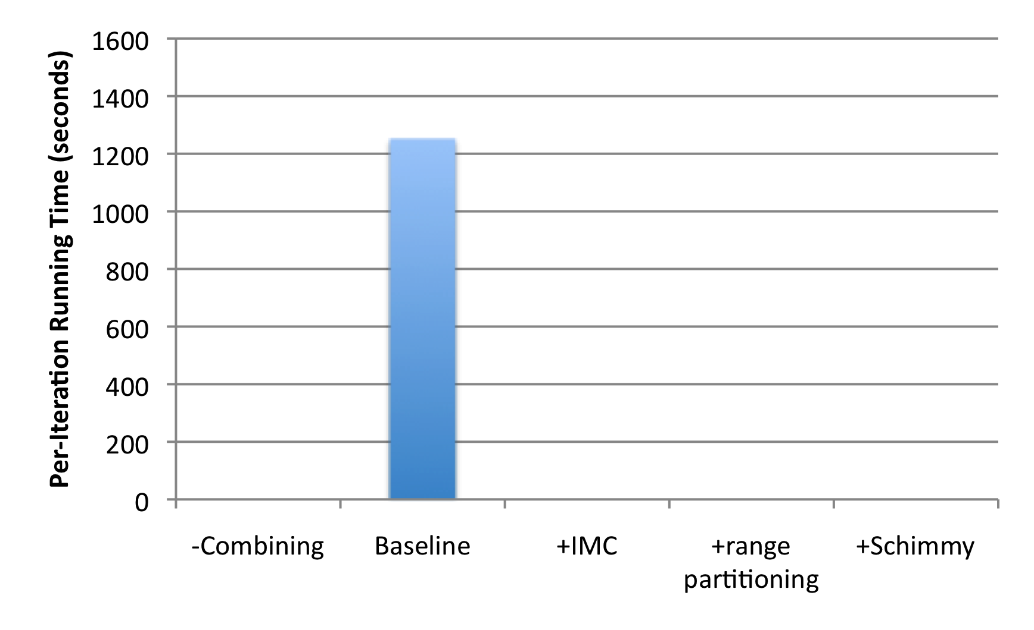
How much difference does it make?
“Best Practices”
PageRank over webgraph (40m vertices, 1.4b edges)
Lin and Schatz. (2010) Design Patterns for Efﬁcient Graph Algorithms in MapReduce.

Slide 23
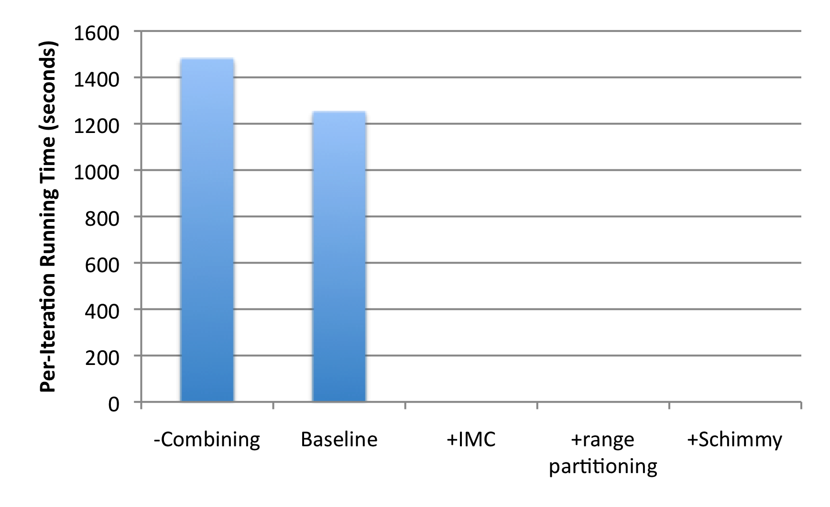
How much difference does it make?
+18%
1.4b
674m
PageRank over webgraph (40m vertices, 1.4b edges)
Lin and Schatz. (2010) Design Patterns for Efﬁcient Graph Algorithms in MapReduce.

Slide 24
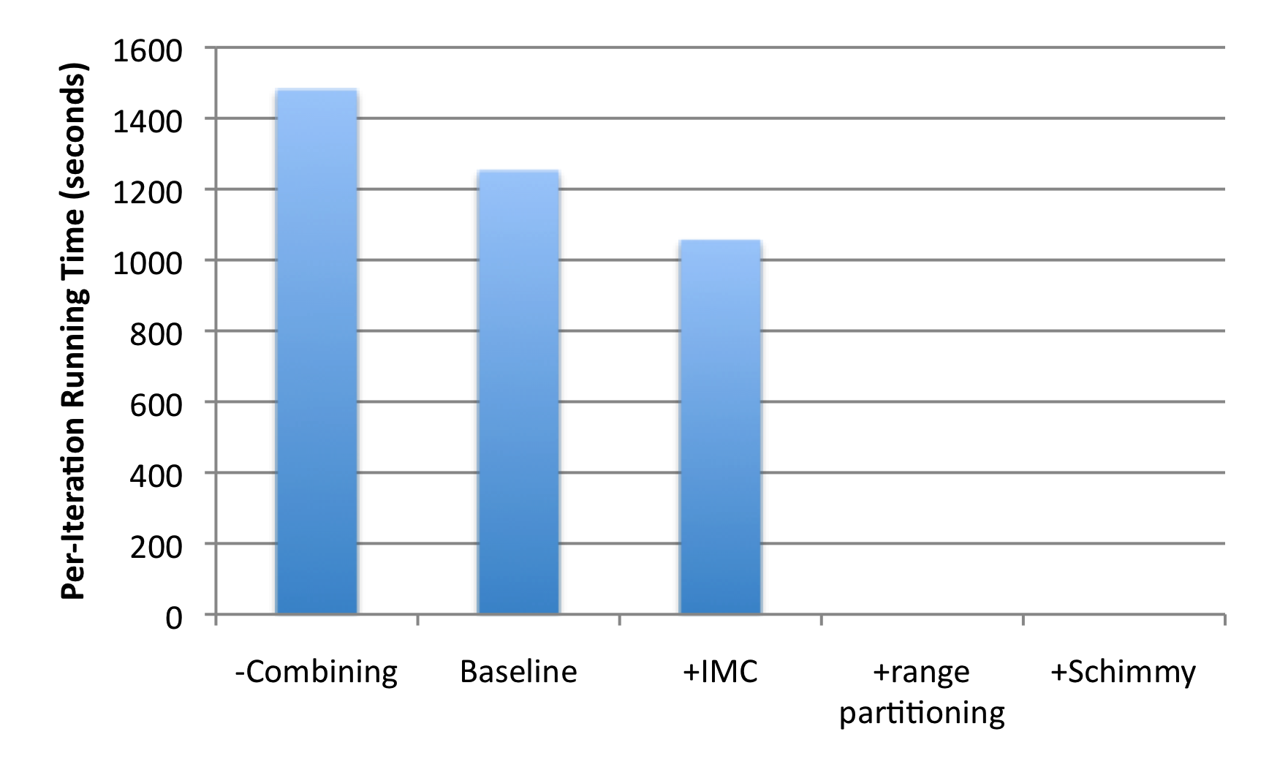
How much difference does it make?
+18%
1.4b
674m
-15%
PageRank over webgraph (40m vertices, 1.4b edges)
Lin and Schatz. (2010) Design Patterns for Efﬁcient Graph Algorithms in MapReduce.

Slide 25
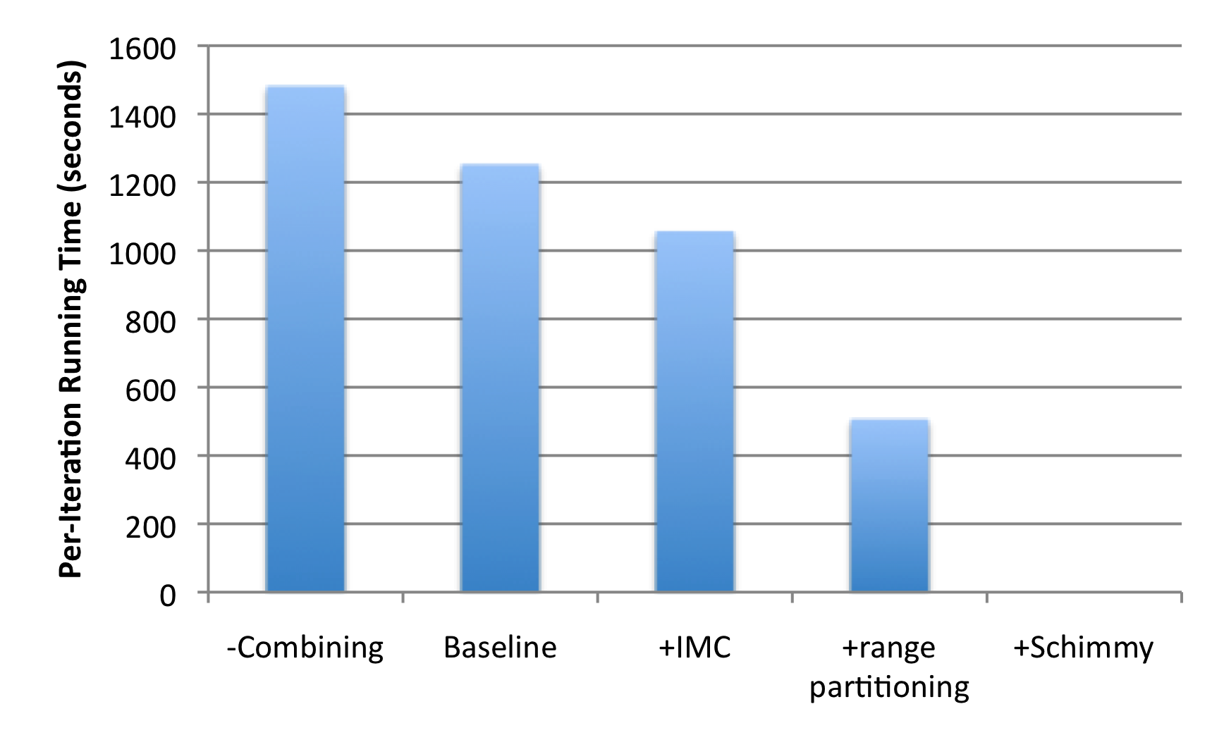
How much difference does it make?
+18%
1.4b
674m
-15%
-60%
86m
PageRank over webgraph (40m vertices, 1.4b edges)
Lin and Schatz. (2010) Design Patterns for Efﬁcient Graph Algorithms in MapReduce.

Slide 26
Schimmy Design Pattern
Basic implementation contains two dataflows:
Messages (actual computations)
Graph structure (“bookkeeping”)
Schimmy: separate the two dataflows, shuffle only the messages
Basic idea: merge join between graph structure and messages
both relations sorted by join key
both relations consistently partitioned and sorted by join key
S
S₁
T
T₁
S₂
T₂
S₃
T₃
Lin and Schatz. (2010) Design Patterns for Efﬁcient Graph Algorithms in MapReduce.

Slide 27
HDFS
HDFS
Adjacency Lists
PageRank vector
join
flatMap
reduceByKey
PageRank vector
join
flatMap
reduceByKey
PageRank vector
join
…

Slide 28
How much difference does it make?
+18%
1.4b
674m
-15%
-60%
86m
PageRank over webgraph (40m vertices, 1.4b edges)
Lin and Schatz. (2010) Design Patterns for Efﬁcient Graph Algorithms in MapReduce.

Slide 29
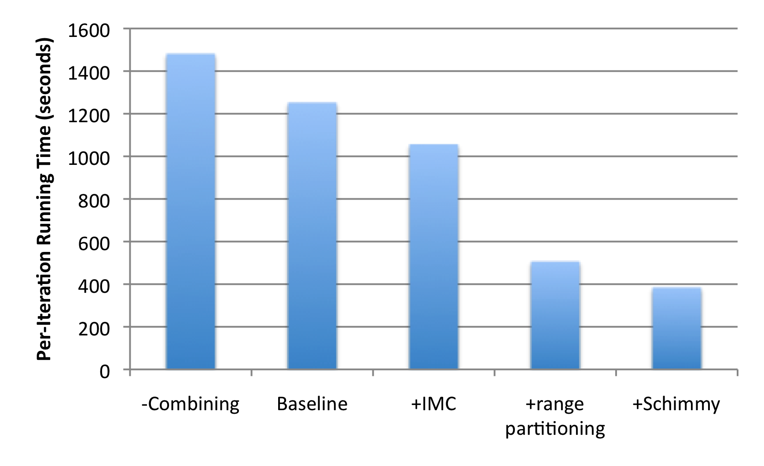
How much difference does it make?
+18%
1.4b
674m
-15%
-60%
86m
-69%
PageRank over webgraph (40m vertices, 1.4b edges)
Lin and Schatz. (2010) Design Patterns for Efﬁcient Graph Algorithms in MapReduce.

Slide 30
Simple Partitioning Techniques
Hash partitioning
Range partitioning on some underlying linearization
Web pages: lexicographic sort of domain-reversed URLs
Social networks: sort by demographic characteristics
Geo data: space-filling curves

Slide 31
Country Structure in Facebook
Analysis of 721 million active users (May 2011)
54 countries w/ >1m active users, >50% penetration
Ugander et al. (2011) The Anatomy of the Facebook Social Graph.

Slide 32
Simple Partitioning Techniques
Hash partitioning
Range partitioning on some underlying linearization
Web pages: lexicographic sort of domain-reversed URLs
Social networks: sort by demographic characteristics
Geo data: space-filling curves

Slide 33
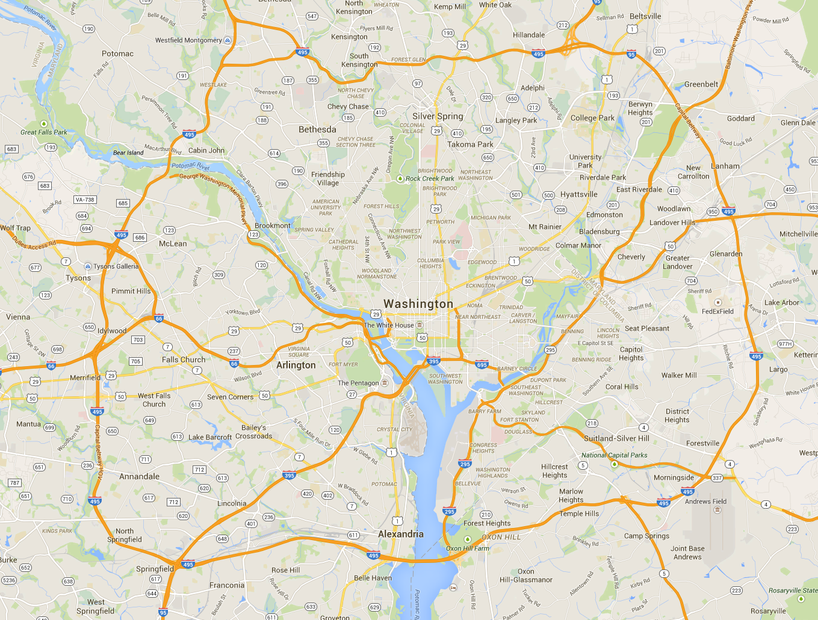
Aside: Partitioning Geo-data

Slide 34
Geo-data = regular graph

Slide 35
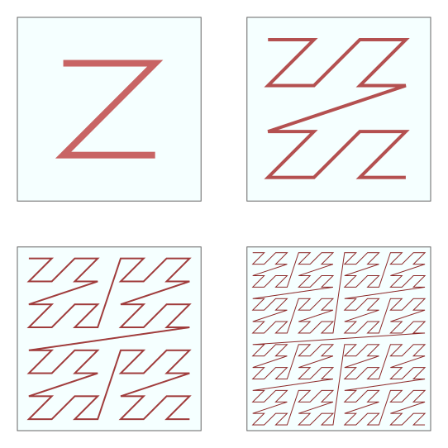
Space-filling curves: Z-Order Curves

Slide 36
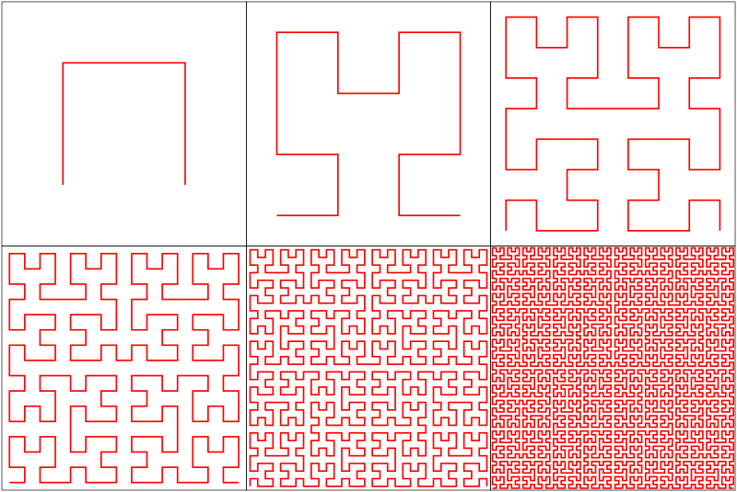
Space-filling curves: Hilbert Curves

Slide 37
Simple Partitioning Techniques
Hash partitioning
Range partitioning on some underlying linearization
Web pages: lexicographic sort of domain-reversed URLs
Social networks: sort by demographic characteristics
Geo data: space-filling curves
But what about graphs in general?

Slide 38


Source: http://www.flickr.com/photos/fusedforces/4324320625/

Slide 39
General-Purpose Graph Partitioning
Recursive bisection
Graph coarsening

Slide 40
General-Purpose Graph Partitioning
Karypis and Kumar. (1998) A Fast and High Quality Multilevel Scheme for Partitioning Irregular Graphs.

Slide 41
Graph Coarsening
Non-trivial problem itself!
Karypis and Kumar. (1998) A Fast and High Quality Multilevel Scheme for Partitioning Irregular Graphs.

Slide 42
Graph Coarsening Challenges
Difficult to identify dense neighborhoods in large graphs
Local methods to the rescue?

Slide 43
Partition

Slide 44
Partition

Slide 45
Partition + Replicate
What’s the issue?
The fastest current graph algorithms combine smart partitioning with asynchronous iterations

Slide 46
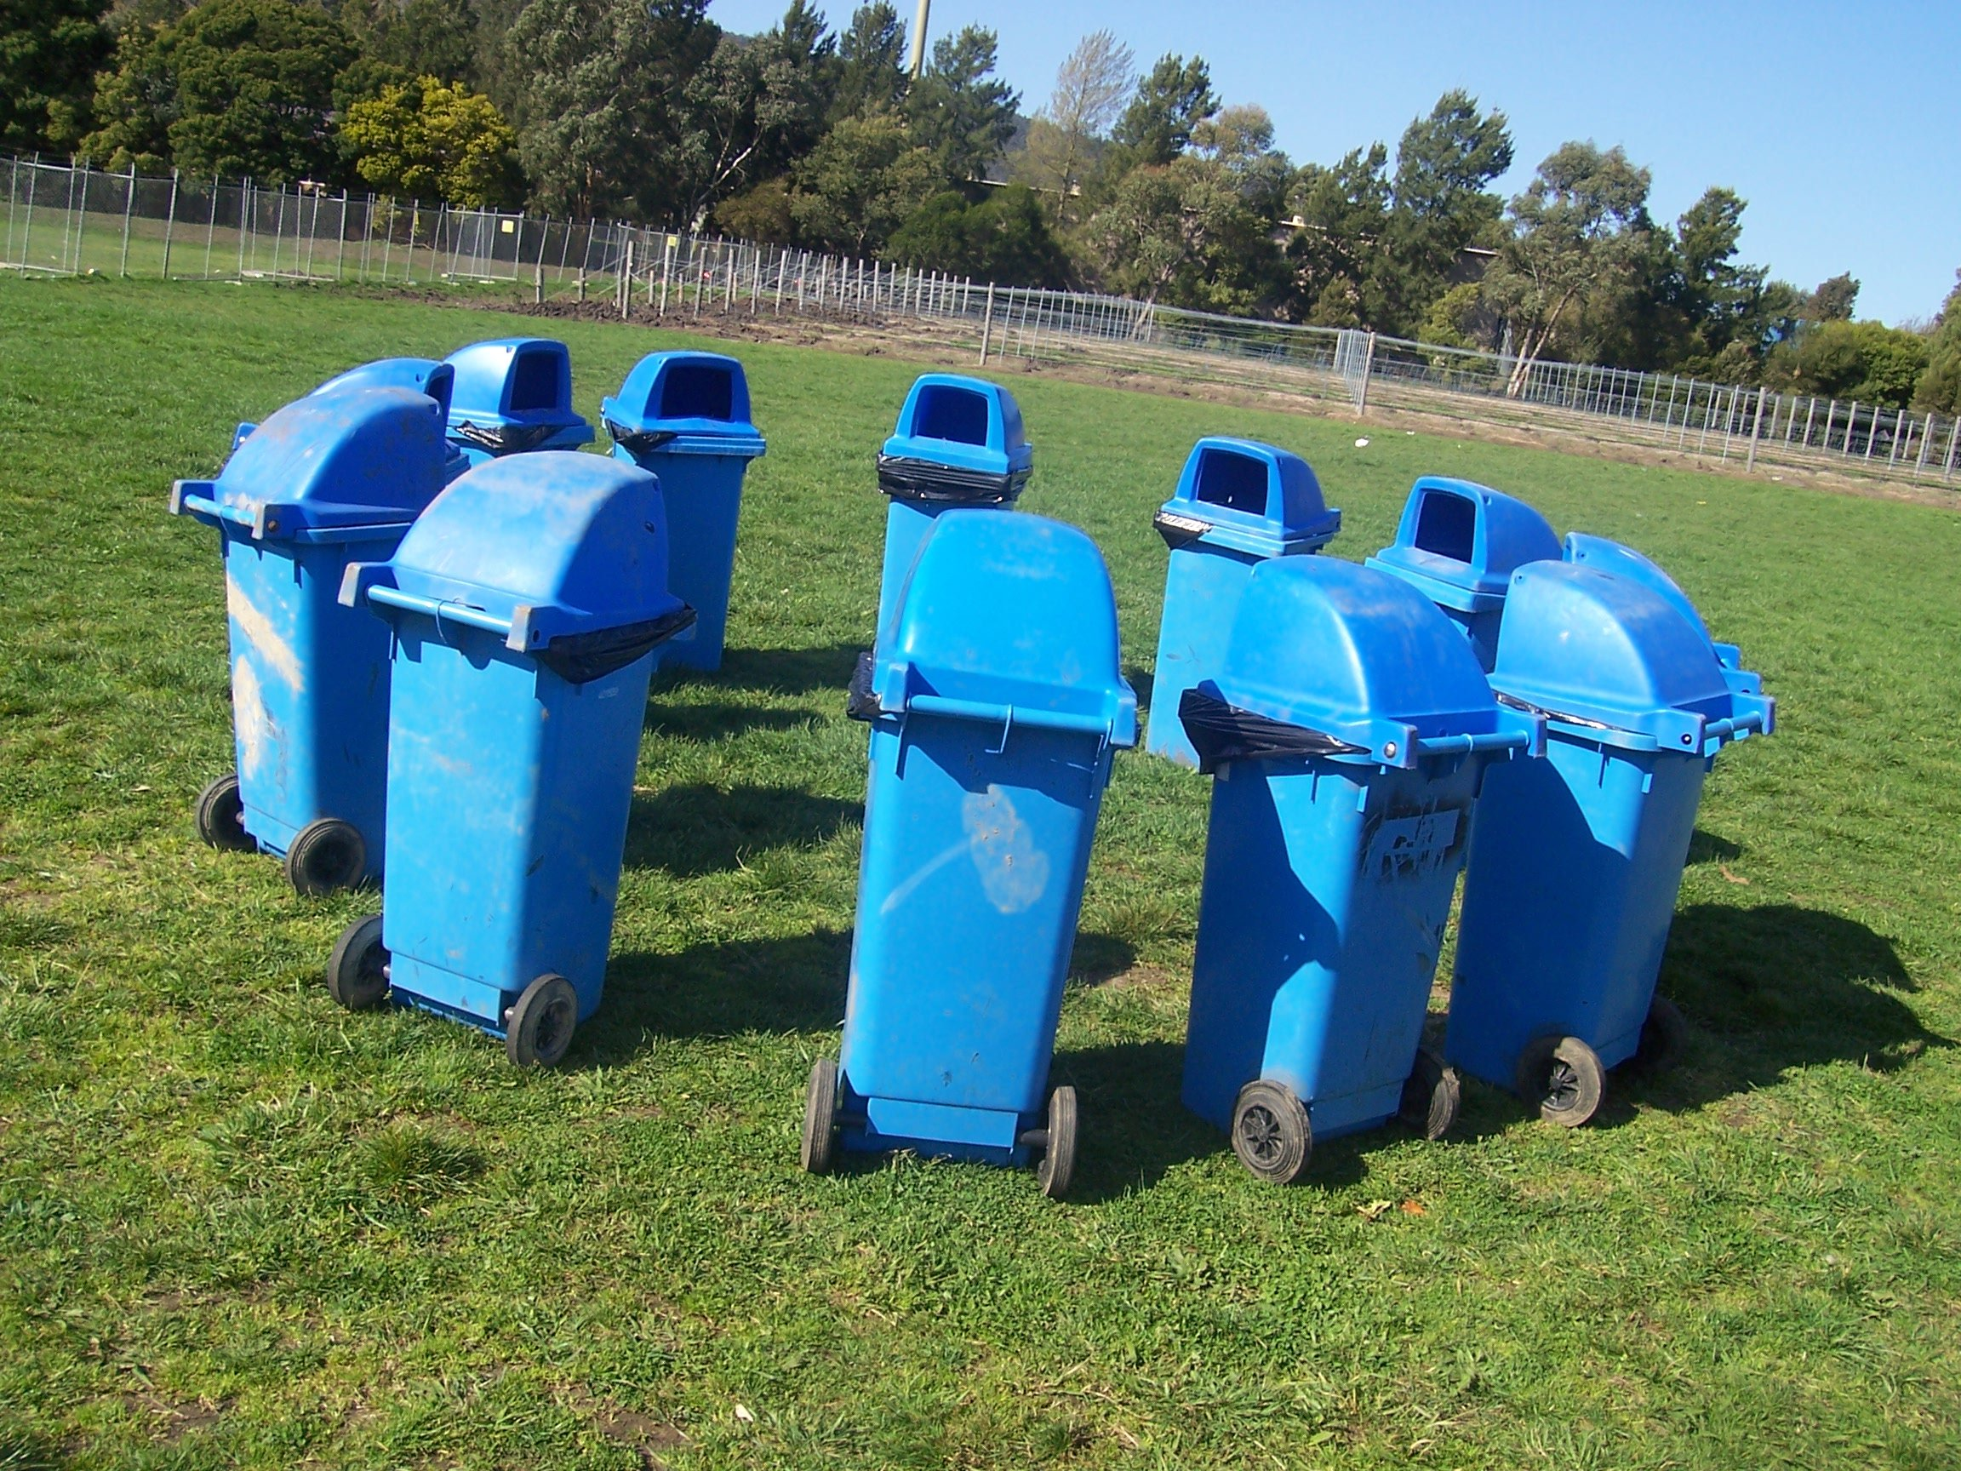
Graph Processing Frameworks
Source: Wikipedia (Waste container)

Slide 47
HDFS
HDFS
Adjacency Lists
PageRank vector
Cache!
join
flatMap
reduceByKey
Still not particularly satisfying?
PageRank vector
join
flatMap
reduceByKey
PageRank vector
join
What’s the issue?
…
Think like a vertex!

Slide 48
Pregel: Computational Model
Based on Bulk Synchronous Parallel (BSP)
Computational units encoded in a directed graph
Computation proceeds in a series of supersteps
Message passing architecture
Each vertex, at each superstep:
Receives messages directed at it from previous superstep
Executes a user-defined function (modifying state)
Emits messages to other vertices (for the next superstep)
Termination:
A vertex can choose to deactivate itself
Is “woken up” if new messages received
Computation halts when all vertices are inactive

Slide 49
superstep t
superstep t+1
superstep t+2
Source: Malewicz et al. (2010) Pregel: A System for Large-Scale Graph Processing. SIGMOD.

Slide 50
Pregel: Implementation
Master-Worker architecture
Vertices are hash partitioned (by default) and assigned to workers
Everything happens in memory
Processing cycle:
Master tells all workers to advance a single superstep
Worker delivers messages from previous superstep, executing vertex computation
Messages sent asynchronously (in batches)
Worker notifies master of number of active vertices
Fault tolerance
Checkpointing
Heartbeat/revert

Slide 51
Pregel: SSSP
class ShortestPathVertex : public Vertex<int, int, int> {
void Compute(MessageIterator* msgs) {
int mindist = IsSource(vertex_id()) ? 0 : INF;
for (; !msgs->Done(); msgs->Next())
mindist = min(mindist, msgs->Value());
if (mindist < GetValue()) {
*MutableValue() = mindist;
OutEdgeIterator iter = GetOutEdgeIterator();
for (; !iter.Done(); iter.Next())
SendMessageTo(iter.Target(),
mindist + iter.GetValue());
}
VoteToHalt();
}
};
Source: Malewicz et al. (2010) Pregel: A System for Large-Scale Graph Processing. SIGMOD.

Slide 52
Pregel: PageRank
class PageRankVertex : public Vertex<double, void, double> {
public:
virtual void Compute(MessageIterator* msgs) {
if (superstep() >= 1) {
double sum = 0;
for (; !msgs->Done(); msgs->Next())
sum += msgs->Value();
*MutableValue() = 0.15 / NumVertices() + 0.85 * sum;
}
if (superstep() < 30) {
const int64 n = GetOutEdgeIterator().size();
SendMessageToAllNeighbors(GetValue() / n);
} else {
VoteToHalt();
}
}
};
Source: Malewicz et al. (2010) Pregel: A System for Large-Scale Graph Processing. SIGMOD.

Slide 53
Pregel: Combiners
class MinIntCombiner : public Combiner<int> {
virtual void Combine(MessageIterator* msgs) {
int mindist = INF;
for (; !msgs->Done(); msgs->Next())
mindist = min(mindist, msgs->Value());
Output("combined_source", mindist);
}
};
Source: Malewicz et al. (2010) Pregel: A System for Large-Scale Graph Processing. SIGMOD.

Slide 55
Giraph Architecture
Master – Application coordinator
Synchronizes supersteps
Assigns partitions to workers before superstep begins
Workers – Computation & messaging
Handle I/O – reading and writing the graph
Computation/messaging of assigned partitions
ZooKeeper
Maintains global application state

Slide 56
Giraph Dataflow
1
2
3
Loading the graph
Compute/Iterate
Storing the graph
Input format
In-memory graph
Output format
Split 0
Worker 0
Load / Send
Graph
Compute / Send
Messages
Part 0
Part 0
Worker 0
Worker 0
Split 1
Part 1
Part 0
Master
Split 2
Master
Part 1
Part 1
Split 3
Load / Send
Graph
Part 2
Compute / Send
Messages
Part 2
Worker 1
Part 3
Worker 1
Worker 1
Part 2
Split 4
Part 3
Part 3
Split
Send stats / iterate!

Slide 57
Giraph Lifecycle
Vertex Lifecycle
Vote to Halt
Active
Inactive
Received Message

Slide 58
Giraph Lifecycle
Input
Compute Superstep
All Vertices Halted?
Yes
Output
No
Master halted?
Yes
No

Slide 59
Giraph Example

Slide 60
Execution Trace
Processor 1
5
5
5
5
Processor 2
1
1
5
5
5
2
2
2
5
5
Time

Slide 61
HDFS
HDFS
Adjacency Lists
PageRank vector
Cache!
join
flatMap
reduceByKey
Still not particularly satisfying?
PageRank vector
join
flatMap
reduceByKey
PageRank vector
join
…
Think like a vertex!

Slide 62
Graph Processing Frameworks
Source: Wikipedia (Waste container)

Slide 63
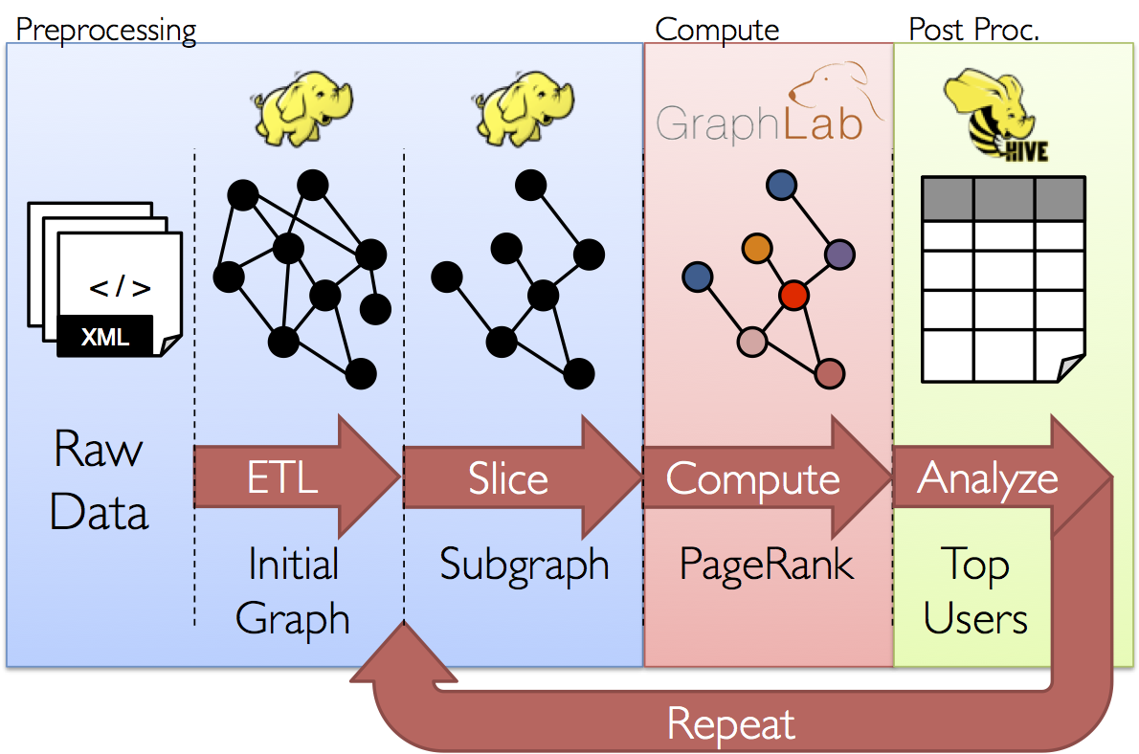
GraphX: Motivation

Slide 64
GraphX = Spark for Graphs
Integration of record-oriented and graph-oriented processing
Extends RDDs to Resilient Distributed Property Graphs
Supported operations
Map operations over views of the graph (vertices, edges, triplets)
Pregel-like computations
Neighborhood aggregations
Join graph with RDDs

Slide 65
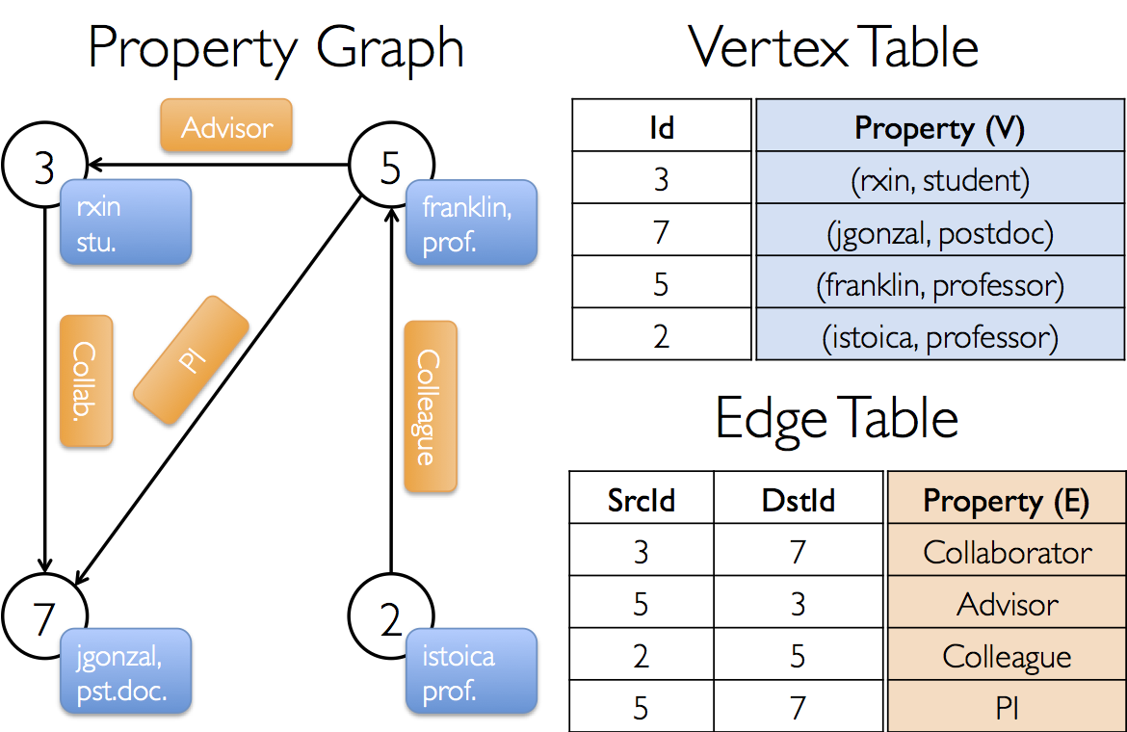
Property Graph: Example

Slide 66
Property Graphs in SparkX
class Graph[VD, ED] {
val vertices: VertexRDD[VD]
val edges: EdgeRDD[ED]
}

Slide 67
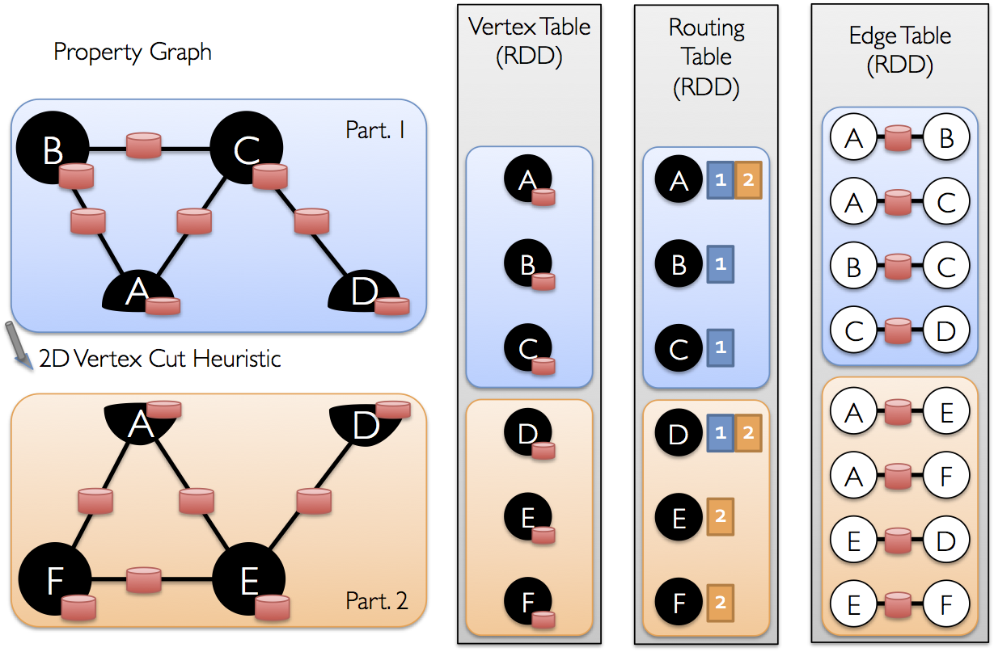
Underneath the Covers

Slide 68
HDFS
HDFS
Adjacency Lists
PageRank vector
Cache!
join
flatMap
reduceByKey
Still not particularly satisfying?
PageRank vector
join
flatMap
reduceByKey
PageRank vector
join
Think like a vertex!
…
(Yeah, but it’s still really all just RDDs)

Slide 69

Questions?
Source: Wikipedia (Japanese rock garden)

